Slide 1
Project 3 Presentation:
Predicting Home
Sale Prices
Maria Yarolin
November 10, 2017

Slide 2
Background
Goal: Employ predictive modeling (i.e. using existing data to develop a model that predicts an outcome) to predict housing sale prices
Target audience: Real estate professionals with a general knowledge of the analytics relevant to their industry, but whom are not data scientists
Data source: Ames Housing Dataset - contains over 70 variables related to homes sold in Ames, IA from 2006-2010; the dataset to build the model includes 2051 cases.

Slide 3
Techniques Used: Preparing the Data
Pre-processing and examining the data:
Fill in missing data on potentially useful variables
Minimal alteration, limited to only a few missing data points
Determine correlation (i.e. the strength of relationship between two variables) of Sale Price and the other variables
Variables with a moderate-to-high correlation with Sale Price were selected for further consideration
Rescale the data to mitigate the effects of variables with different units of measurement

Slide 4
Techniques Used: Predictions
Modeling:
SelectKBest - determines what features to include in a model by removing the lower-performing ones and retaining only the best features
Features selected for the model: Overall quality, Ground floor living area sq.ft, Garage area, # of cars in garage, Total Basement sq.ft, 1st Floor sq.ft, Total rooms above ground, Year built, Year remodeled/added
Multiple Linear Regression - models the relationship between two or more predictor variables and a response variable (Sale Price) by fitting a linear equation to observed data

Slide 5
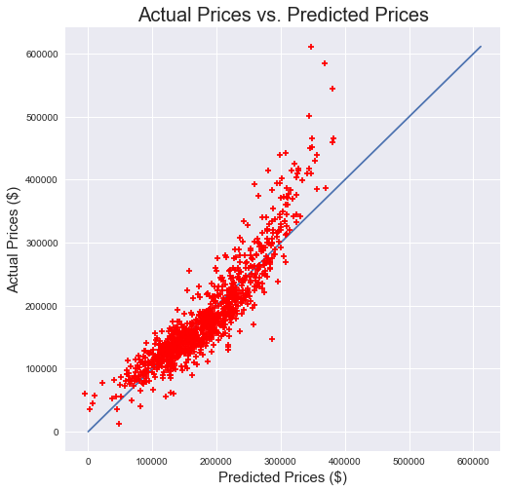
Model Performance: Price Predictions
The closer the points are to the line, the better the fit.
The model is good at predicting sale prices at the low-to-moderate range, but is less effective for predicting prices at the higher end of the range.
The R² score is 0.815481856581, meaning that this model explains 81% of the variation in housing prices. The remaining 19% of variation is attributed to other factors not addressed by this model.

Slide 6
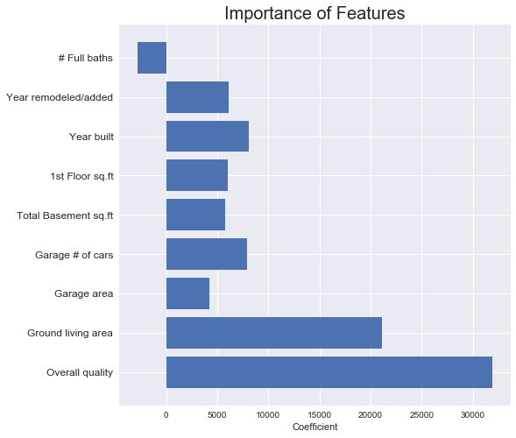
Model Performance: Feature Importance
By far, overall material and finish quality is the most important feature in determining housing prices, followed by the square footage of living area above grade (ground).

